Slide 1

CAP 6317/4773: Social Media Mining
Lecture 17: Community Detection
Raiyan Abdul Baten, Ph.D.
March 7, 2024

Slide 2
Recap

Slide 3
Boosting: AdaBoost
Two major changes:
Weights are assigned to each data point
Goal: Give more attention to the ‘harder’ data points
Weights are assigned to each model
Goal: Give more attention to the better performing models
Voting is not democratic any more – if you’re a better performer, you vote matters more

Slide 4
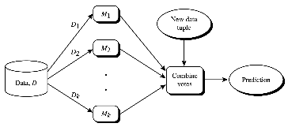
Boosting: AdaBoost
Iteratively fit the models in the ensemble:
Start with the same weight of 1/d for all data points
Sample with replacement, but the sampled dataset can be of any size
Each datapoint is equally likely to be picked
After a classifier, M_{i} , is trained:
Assign the model a weight based on its accuracy
Increase weights of misclassified data points, decrease weights of correctly classified data points
For the next model M_{i+1} , use weighted sampling to preferentially pick the misclassified data points

Slide 5
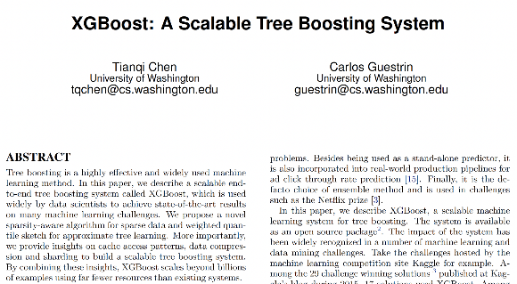
XGBoost is a clever implementation of Tree Boosting
Efficient regularization (both LASSO and Ridge),
Better parallel processing, cache access, data compression
Better handling of sparse data
The core principles and intuitions behind tree ensembling are exactly the same

Slide 6
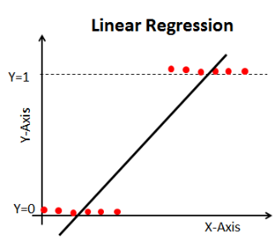
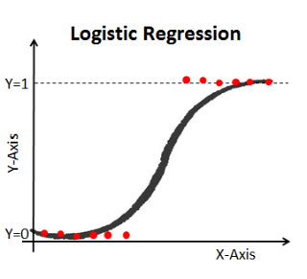
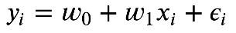
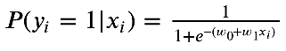
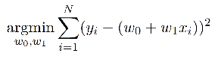
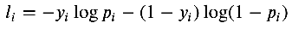
Logistic Regression

Slide 7
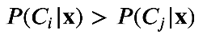
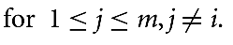

Naive Bayes Classification
Data point x belongs to the class C_{i} if and only if the probability of the data point belonging to any other class is lower:
We don’t really care about the actual probabilities. We just need to know enough to make the comparisons

Slide 8
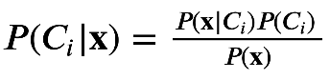
Naive Bayes Classification
Data point x belongs to the class C_{i} if and only if the probability of the data point belonging to any other class is lower:
This one’s tricky…

Slide 9
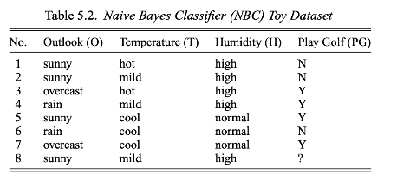
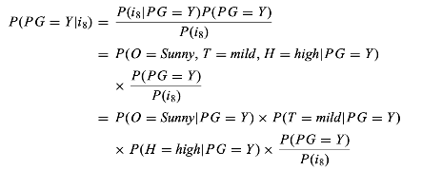
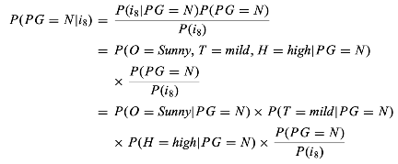
Compare P( PG = Y | i₈ ) and P( PG = N | i₈ )
The naive assumption! We are assuming that all features are independent of each other (which is clearly not the case in the real world). If the features are independent, then their joint probability can be broken down as a multiplication of the individual probabilities

Slide 10
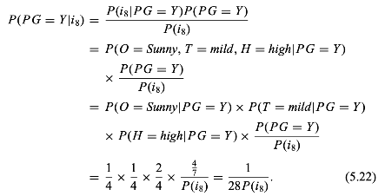
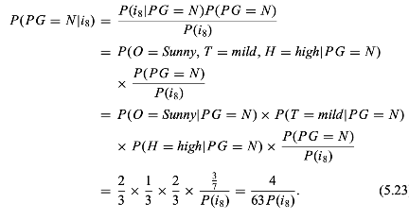
Compare P( PG = Y | i₈ ) and P( PG = N | i₈ )
P( PG = N | i₈ ) is higher, so the predicted class is PG = N

Slide 11
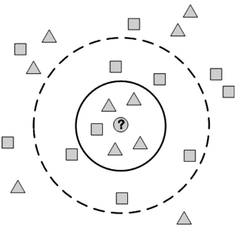
k-NN Classification
x₂
If the feature are numeric, Cartesian distance may be reasonable to use!
For 5-NN, find the 5 data points with the lowest Cartesian distance from the target data point, and do majority voting to decide the predicted class.
x₁

Slide 12
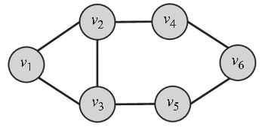
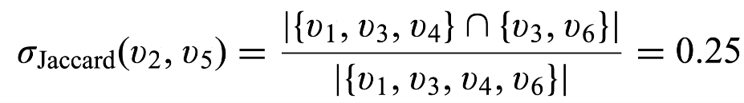
Capturing Structural Equivalence
N(v₂) = {v₁, v₃, v₄}
N(v₅) = {v₃, v₆}

Slide 13
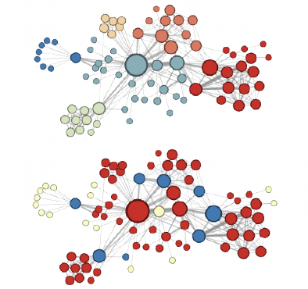
k-NN Classification
You can do k-NN classification on graphs as well!
Instead of Euclidean distance, use Jaccard similarity!
Find the 5 most similar nodes, do majority voting to predict the class

Slide 14
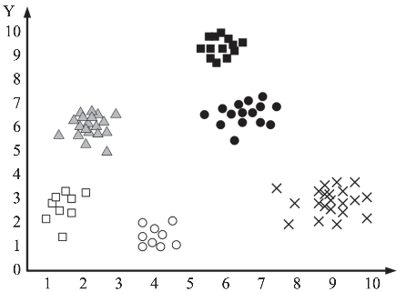
k-means Clustering
x₂
x₁

Slide 15


Slide 16
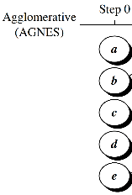
Hierarchical Clustering

Slide 17
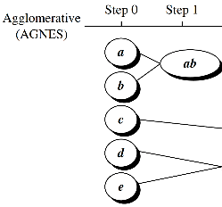
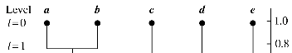
Hierarchical Clustering

Slide 18
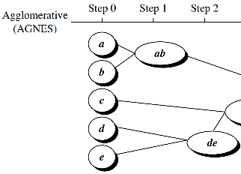
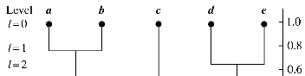
Hierarchical Clustering

Slide 19
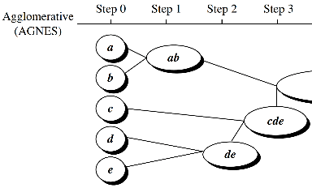
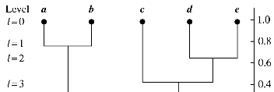
Hierarchical Clustering

Slide 20
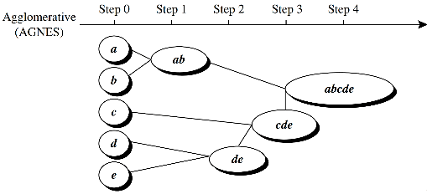
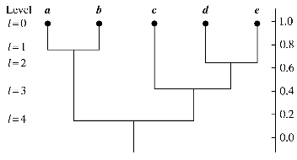
Hierarchical Clustering

Slide 21
Hierarchical Clustering

Slide 22
Hierarchical Clustering

Slide 23
Hierarchical Clustering

Slide 24
Hierarchical Clustering

Slide 25
Social Science
Network Science
Social Media Mining
Statistics and Data Mining

Slide 26
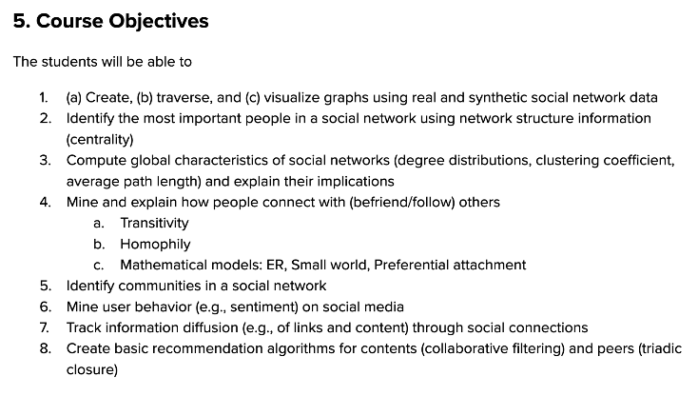

Slide 30
Reminder to self: Attendance

Slide 31
Machine Learning on Graphs

Slide 32
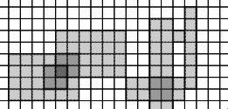

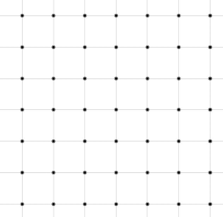

Slide 33
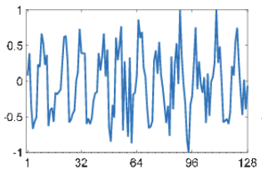
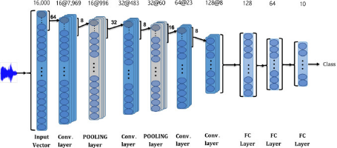
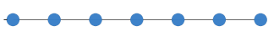

Slide 34
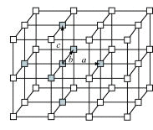

Slide 35
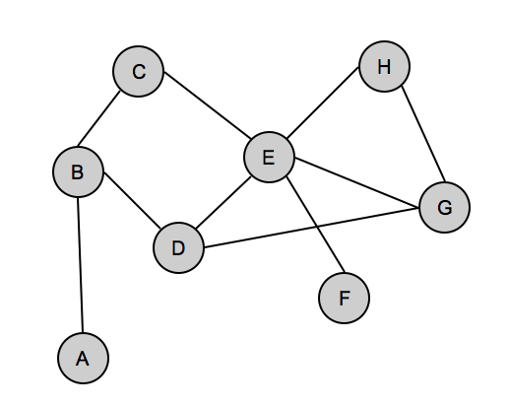

Slide 36
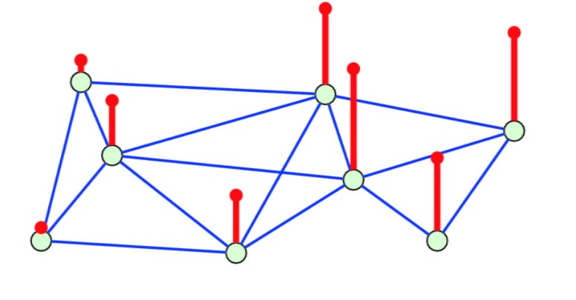
Supervised Learning Tasks on Graphs

Slide 37
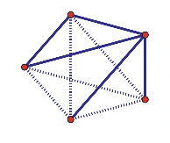
Supervised Learning Tasks on Graphs
The ground truth. We know the nodes. We know that some edges exist (solid lines). We know that some edges don’t exist (dotted lines).

Slide 38
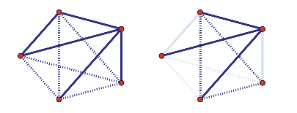
Supervised Learning Tasks on Graphs
The light blue edges are hidden. The supervised learning task is to predict whether those edges exist or not based on the node attributes and the observed edges. You can design a peer recommendation engine around this prediction framework!

Slide 39
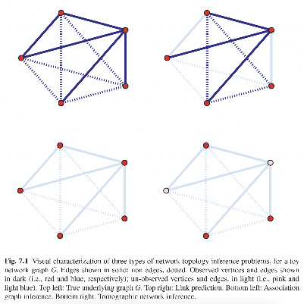
Supervised Learning Tasks on Graphs
Trickier task. ALL edges are hidden, you need to predict the existence of those edges just based on node attributes.

Slide 40
Supervised Learning Tasks on Graphs
Trickiest. You don’t observe the edges. You don’t even observe some of the nodes. Now try to predict the edges!

Slide 41
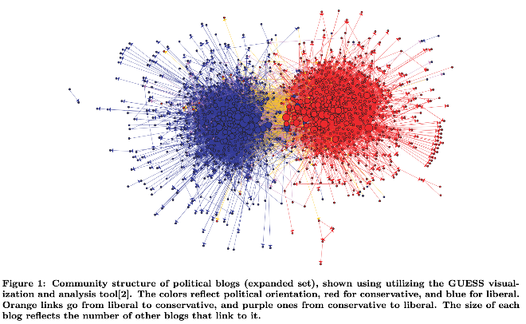
Unsupervised Learning Tasks on Graphs

Slide 42
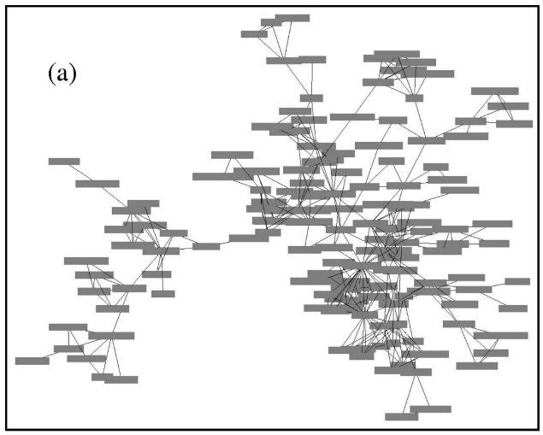
Newman, Mark EJ, and Michelle Girvan. "Finding and evaluating community structure in networks." Physical review E 69.2 (2004): 026113.

Slide 43
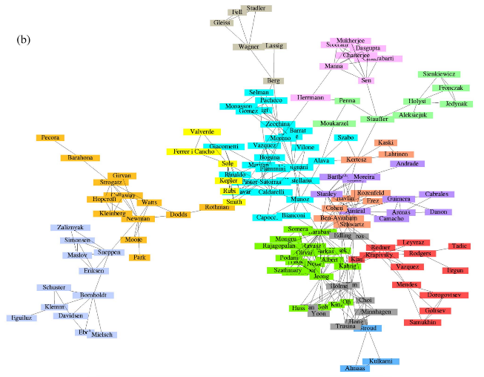
Newman, Mark EJ, and Michelle Girvan. "Finding and evaluating community structure in networks." Physical review E 69.2 (2004): 026113.

Slide 44
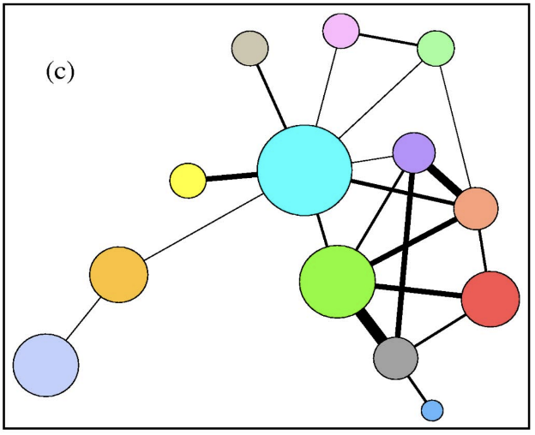
Newman, Mark EJ, and Michelle Girvan. "Finding and evaluating community structure in networks." Physical review E 69.2 (2004): 026113.

Slide 45
Graph Clustering/ Community Detection

Slide 46
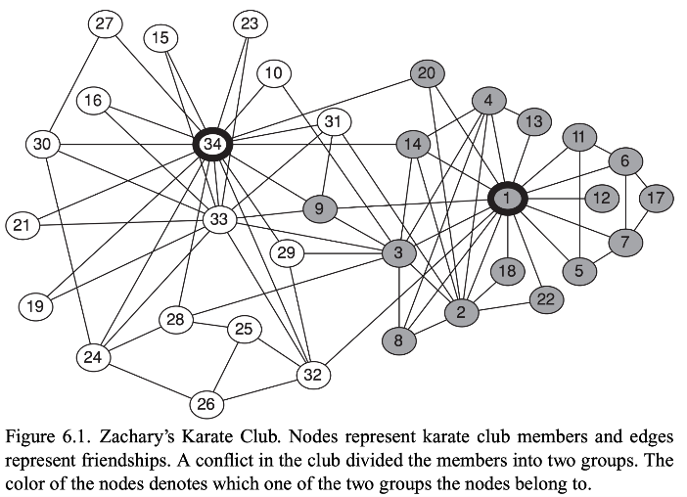

Slide 47
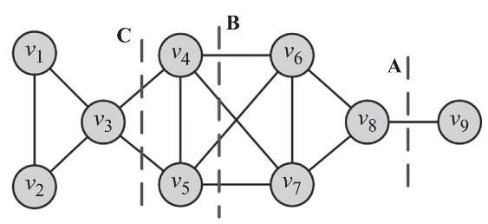
Minimum Cut
A cut in a graph is a partitioning (cut) of the graph into two (or more) sets.
The size of the cut is the number of edges that are being cut
How do we partition the graph below into two with the least cut size?

Slide 48
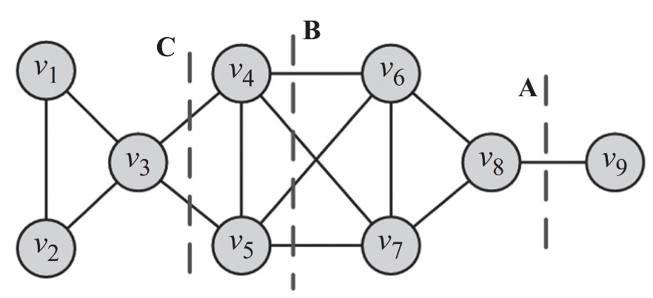
Minimum Cut

Slide 49
Minimum Cut

Slide 50
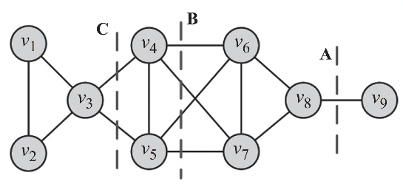
Minimum Cut
We want to partition graph G into k non-overlapping partitions, {P₁, P₂, … , P_{k})
For k=2, we need to split the graph into P₁ and P₂.
Minimum cut:
Minimize cut(P₁ , P₂)
P₂
P₁

Slide 51

Ratio Cut
Ratio cut:
Minimize

Slide 52
Ratio Cut
Ratio cut:
Minimize = ½ (1/1 + ⅛) = 0.56
Ratio cut: 0.56

Slide 53
Ratio Cut
Ratio cut:
Minimize
Ratio cut: 0.9
Ratio cut: 0.56

Slide 54
Ratio Cut
Ratio cut:
Minimize
Ratio cut: 0.9
Ratio cut: 0.5
Ratio cut: 0.56

Slide 55
Ratio Cut
Ratio cut:
Minimize
P₁
P₂

Slide 56
Recap: Agglomerative Hierarchical Clustering

Slide 57
Similarity between nodes can be quantified!
N(v₂) = {v₁, v₃, v₄}
N(v₅) = {v₃, v₆}

Slide 58

Agglomerative Hierarchical Clustering in Graphs
Start with 9 clusters for the 9 nodes. Pick the most similar pair of nodes, put them in the same cluster. Repeat.

Slide 59
Agglomerative Hierarchical Clustering in Graphs
Start with 9 clusters for the 9 nodes. Pick the most similar pair of nodes, put them in the same cluster. Repeat.
Erm, do we really want to start with a billion clusters in a large social graph?

Slide 60
Divisive Hierarchical Clustering in Graphs
Agglomerative: the least costly merge of two previously existing partitions
Divisive: the least costly split of a single existing partition into two partitions

Slide 61

We need a measure of dissimilarity between nodes
Dissimilarity between nodes v_{i} and v_{j}

Slide 62
We need a measure of dissimilarity between nodes
N(v_{i}) △ N(v_{i})
= (N(v_{i}) -N(v_{j})) ∪ (N(v_{j}) -N(v_{i}))
Remember, the set A−B consists of elements that are in A but not in B. For example if A={1,2,3} and B={3,5}, then A−B={1,2}
The N(v_{i}) △ N(v_{i}) expression finds peers that are unique to v_{i} and v_{j}, and takes the union of those peer sets

Slide 63
We need a measure of dissimilarity between nodes
Sum of the highest and second-highest degrees in the degree sequence. Helps normalize x_{ij} to fall between 0 (perfect similarity) and 1 (perfect dissimilarity)

Slide 64

Divisive Hierarchical Clustering in Graphs
Start with a single cluster with all 9 nodes. Use Ward’s method [1] to calculate the dissimilarity among node subsets using x_{ij}. Find the split that gives the best split to partition the original cluster. Repeat.
[1] Ward Jr, Joe H. "Hierarchical Grouping to Optimize an Objective Function." Journal of the American Statistical Association 58.301 (1963): 236-244.

Slide 65

Divisive Hierarchical Clustering: Girvan-Newman Algorithm

Slide 66

Divisive Hierarchical Clustering: Girvan-Newman Algorithm
Intuition:
Communities will have a lot of ties within the community and only a few ties between communities.
Then, all shortest paths between members of different communities should pass through those weak ties!

Slide 67
Divisive Hierarchical Clustering: Girvan-Newman Algorithm
Edge betweenness
For an edge e, edge betweenness is defined as the number of shortest paths between node pairs (v_{i}, v_{j}) such that the shortest path between v_{i} and v_{j} passes through e.
Remove edges with the highest edge betweenness!

Slide 68

Divisive Hierarchical Clustering: Girvan-Newman Algorithm
Calculate edge betweenness for all edges in the graph
Remove the edge with the highest edge betweenness
Recalculate betweenness for all edges affected by the edge removal
Repeat until all edges are removed

Slide 69

Spectral Clustering
Binary splits a graph into k = 2 clusters
Repeat to get 4, 8, 16 clusters.

Slide 70
A Detour on the Graph Laplacian

Slide 71



A Detour on the Graph Laplacian
i
j

Slide 72
A Detour on the Graph Laplacian
The ‘substance’ flows from vertex j to adjacent i at a rate
Where C is a diffusion constant.
i
j

Slide 73
A Detour on the Graph Laplacian
The ‘substance’ flows from vertex j to adjacent i at a rate
Where C is a diffusion constant.
Then, in a small time interval dt, the total flow of substance from j to i is
i
j

Slide 74
A Detour on the Graph Laplacian
In a small time interval dt, the total flow of substance from j to i is
i
j

Slide 75

A Detour on the Graph Laplacian
In a small time interval dt, the total flow of substance from j to i is
i
j

Slide 76

A Detour on the Graph Laplacian
In a small time interval dt, the total flow of substance from j to i is
i
Summing over all j’s, the changing rate of substance at node i is:
j

Slide 77
A Detour on the Graph Laplacian

Slide 78

A Detour on the Graph Laplacian

Slide 79

A Detour on the Graph Laplacian

Slide 80


A Detour on the Graph Laplacian
Use Kronecker delta to switch from Ψ_{i} to Ψ_{j}

Slide 81




A Detour on the Graph Laplacian
i
j

Slide 82
A Detour on the Graph Laplacian
i
j
Vectorized form of the same equation as above

Slide 83
A Detour on the Graph Laplacian
i
j
D is the degree matrix: it has degree centralities along its diagonal and 0’s elsewhere

Slide 84
A Detour on the Graph Laplacian
Let’s represent D-A using L. L is known as the Graph Laplacian - a remarkably useful matrix!

Slide 85

A Detour on the Graph Laplacian
same form as the ordinary diffusion equation for a gas!

Slide 86


A Detour on the Graph Laplacian

Slide 87



Slide 89
Spectral Clustering
A graph G will consist of K connected components if and only if

Slide 90
Spectral Clustering
A graph G will consist of K connected components if and only if
English:
You calculate the Graph Laplacian for a given graph. Take its Eigenvalues. Order the Eigenvalues of the Graph Laplacian from small to large.
If there are K connected components, you will find K of those eigenvalues to be 0.
(The first eigenvalue will always be zero)

Slide 91


If we have two completely detached components, the first two Eigenvalues will be zero. Not very useful!

Slide 92

If we have two highly polarized clusters, then the second eigenvalue λ₂(L) will be close to zero
Known as the Fiedler Eigenvalue

Slide 93
If we have two highly polarized clusters, then the second eigenvalue λ₂(L) will be close to zero
Very useful: the smaller λ₂(L) is, the more amenable the graph is to being separated into two subgraphs (i.e., more polarized)

Slide 94
Binary partitioning of graphs then becomes extremely easy:
Take the Eigenvector associated with the second smallest Eigenvalue λ₂(L)
The signs of the entries of this Eigenvector tell you which node belongs to which cluster!

Slide 95

Binary partitioning of graphs then becomes extremely easy:
Take the Eigenvector associated with the second smallest Eigenvalue λ₂(L)
The signs of the entries of this Eigenvector tell you which node belongs to which cluster!

Slide 96

Binary partitioning of graphs then becomes extremely easy:
Take the Eigenvector associated with the second smallest Eigenvalue λ₂(L)
The signs of the entries of this Eigenvector tell you which node belongs to which cluster!

Slide 97

Binary partitioning of graphs then becomes extremely easy:
Take the Eigenvector associated with the second smallest Eigenvalue λ₂(L)
The signs of the entries of this Eigenvector tell you which node belongs to which cluster!

Slide 98
Binary partitioning of graphs then becomes extremely easy:
Take the Eigenvector associated with the second smallest Eigenvalue λ₂(L)
The signs of the entries of this Eigenvector tell you which node belongs to which cluster!

Slide 100
References
Chapter 6 of the textbook
Data Mining: Concepts and Techniques, 3rd edition, by Jiawei Han, Michelin Kamber, and Jian Pei
Networks: An Introduction, MEJ Newman
Statistical Analysis of Networked Data: Methods and Models, Erik D. Kolaczyk

Slide 101
Summary

